Slide 1
Design – Object Oriented Approach

Slide 2
We have seen ...
Requirement Specification – SRS
Design Principles
Cohesion
Coupling
Modularity
Notes:
Basics of design – cohesion, coupling , modularity

Slide 3
Design Approach
Modelling functionalities – Starting point of design
Design can be approached in different ways
Conventional functional oriented or procedural approach
Top-down approach
Structured Analysis
Data flow diagrams, structure chart
Object oriented approach
Bottom up approach
UML for modelling
Notes:
What are the design goals in this phase? In this phase we are trying to define or do a design of the processing component, because the requirements are clearly defined in the processing needs of the user. So these processing components will be converted into software. We have a functional approach as well as we have an object oriented approach. Different alternatives are available for design methodologies. They may be conventional functional development or it could be object oriented development. There are different methodologies available for the paradigms
So if it is a functional paradigm you may use structured system analysis and design methodology, which is based on taking data flow diagrams and converting them into software architecture.
On the object oriented approach the software consists of different classes. In fact class is the main concept in the object oriented approach, where it has both the data associated with the class and the executable functions associated with the class. So we call these as structure and behavior for a class. This is a paradigm which combines the data and the processing to get them on a single dimension and identifies classes which have structural properties and which has a behavior or methods defined for them. It is a completely different paradigm and we will see more details of this subsequently. Object oriented paradigm is very useful and has occupied very important position in the design of software. And it simplifies greatly, the complex software development. It has not only a new notion of a class as a unit for organizing the processing as well as the structure, but it provides a concept of inheritance which allows us to reuse the software from other existing components. We use class diagrams to show the static structure of the system. The class diagram identifies what are these different class components
So we will see this object oriented approach subsequently in much more details. The only point we want to make here is that there are different ways in which the design can be approached. It could be the conventional approach where the architecture consists of functional modules depicted in the form of a structure chart or it could be an object oriented approach. Object oriented approach will decompose also large system into various packages. So the principles are similar that you use the decomposition technique into convert the large software into smaller components these components may be modules or they may be classes and we organize the data and processing among these

Slide 4
Procedural paradigm:
Software is organized around the notion of procedures
Procedural abstraction
Works as long as the data is simple
Adding data abstractions
Groups together the pieces of data that describe some entity
Helps reduce the system’s complexity.
Such as Records and structures
Object oriented paradigm:
Organizing procedural abstractions in the context of data abstractions

Slide 5
Object Oriented paradigm
An approach to the solution of problems in which all computations are performed in the context of objects.
The objects are instances of classes, which:
are data abstractions
contain procedural abstractions that operate on the objects
A running program can be seen as a collection of objects collaborating to perform a given task

Slide 6
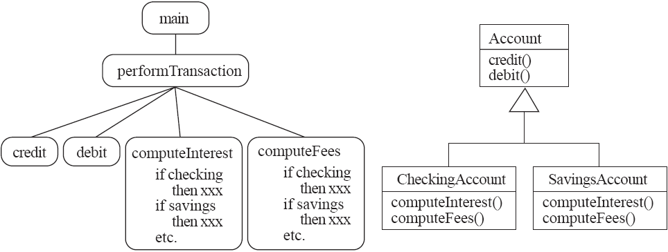
A View of the Two paradigms
Notes:
Maintainable code

Slide 7
Classes and Objects
Object
A chunk of structured data in a running software system
Has properties
Represent its state
Has behaviour
How it acts and reacts
May simulate the behaviour of an object in the real world
Notes:
An entity having some properties and behavor

Slide 8
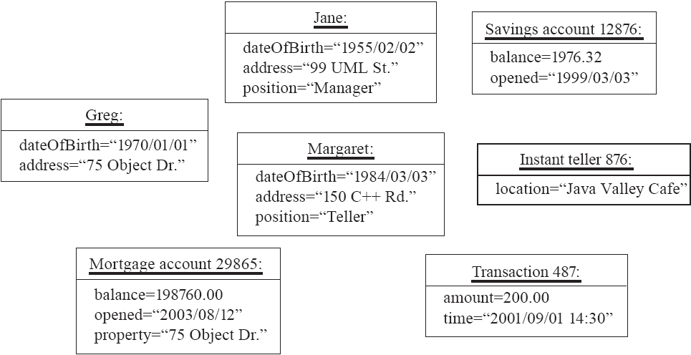
Objects

Slide 9
Classes
A class:
A unit of abstraction in an object oriented (OO) program
Template or blueprint of objects
A kind of software module
Describes its object structure (properties)
Contains methods to implement their behaviour

Slide 10
Is Something a Class or an Instance?
Something should be a class if it could have instances
Something should be an instance if it is clearly a single member of the set defined by a class
Student
Class; instances are individual students.
Course
Class; instance is CS3004 SE
Teacher with Employee ID – CSED100
Instance of Class Teacher

Slide 11
Instance Variables
Variables defined inside a class corresponding to data present in each instance
Also called fields or member variables
Attributes
Simple data
E.g. name, dateOfBirth
Associations
Relationships to other important classes
E.g. supervisor, coursesTaken

Slide 12
Variables vs. Objects
A variable
Refers to an object
May refer to different objects at different points in time
Eg:
Student s1 = new Student();
s1.name = “ABC”;
s1.computeGrade();
An object can be referred to by several different variables at the same time
Student s2 = new Student();
s2 = s1;
Type of a variable
Determines what classes of objects it may contain

Slide 13
Methods and Polymorphism
Method
A procedural abstraction used to implement the behaviour of a class
Several different classes can have methods with the same name
They implement the same abstract operation in ways suitable to each class
E.g. calculating area in a rectangle is done differently from in a circle

Slide 14
Polymorphism
A property of object oriented software by which an abstract operation may be performed in different ways in different classes.
Requires that there be multiple methods of the same name
The choice of which one to execute depends on the object that is in a variable
Reduces the need for programmers to code many if-else or switch statements

Slide 15
Organizing Classes into Inheritance Hierarchies
Superclasses
Contain features common to a set of subclasses
Inheritance hierarchies
Show the relationships among superclasses and subclasses
A triangle shows a generalization
Inheritance
Subclasses implicitly have the features defined in its superclasses

Slide 16
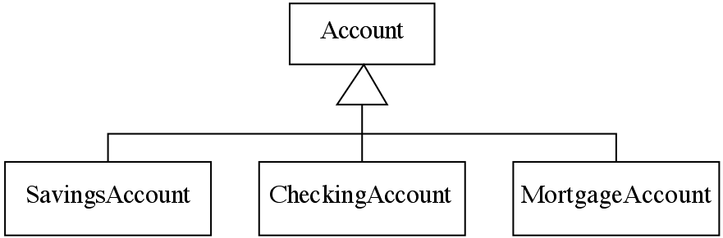
An Example Inheritance Hierarchy
Inheritance
Subclasses implicitly have the features defined in its superclasses

Slide 17
The Is A Rule
Always check generalizations to ensure they obey the isa rule
“A checking account is an account”
“A student is a person”
Is ‘State’ a subclass of ‘Country’?
No, it violates the is a rule

Slide 18
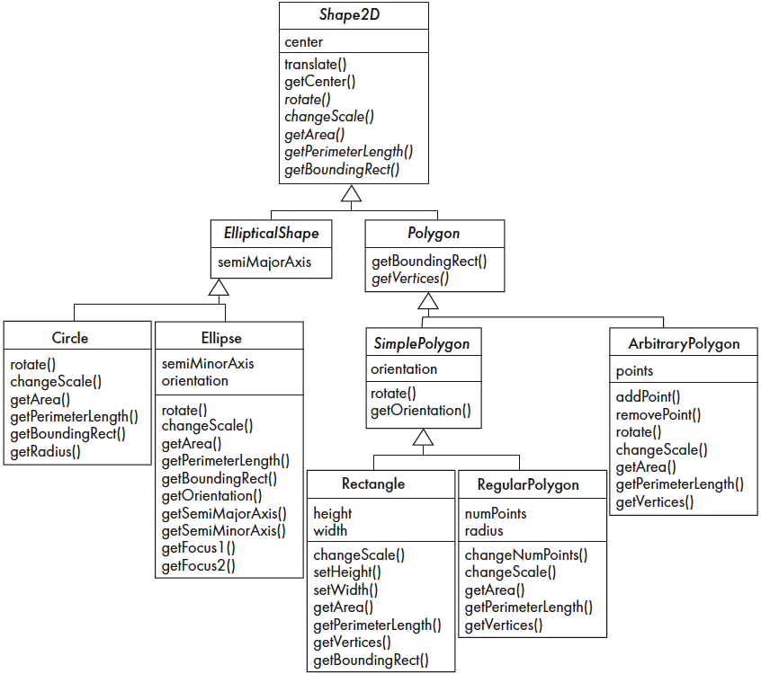
Inheritance, Polymorphism and Variables

Slide 19
Some Operations in the Shape Example

Slide 20
Abstract Classes and Methods
An operation should be declared to exist at the highest class in the hierarchy where it makes sense
The operation may be abstract (lacking implementation) at that level
If so, the class also must be abstract
No instances can be created
The opposite of an abstract class is a concrete class
If a superclass has an abstract operation then its subclasses at some level must have a concrete method for the operation
Leaf classes must have or inherit concrete methods for all operations
Leaf classes must be concrete

Slide 21
Overriding
A method would be inherited, but a subclass contains a new version instead
For restriction
For extension
For optimization

Slide 22
How a decision is made on which method to run?
Rectangle obj = new Rectangle();
obj.getBoundingRect();
Shape2D obj= new Rectangle();
obj.getBoundingRect();
If there is a concrete method for the operation in the current class, run that method.
Otherwise, check in the immediate superclass to see if there is a method there; if so, run it.
Repeat step 2, looking in successively higher superclasses until a concrete method is found and run.
If no method is found, then there is an error

Slide 23
Dynamic binding
Occurs when decision about which method to run can only be made at run time
Needed when:
A variable is declared to have a superclass as its type, and
There is more than one possible polymorphic method that could be run among the type of the variable and its subclasses

Slide 24
Concepts that Define Object Orientation
The following are necessary for a system or language to be OO
Identity
Each object is distinct from each other object, and can be referred to
Two objects are distinct even if they have the same data
Classes
The code is organized using classes, each of which describes a set of objects
Inheritance
The mechanism where features in a hierarchy inherit from superclasses to subclasses
Polymorphism
The mechanism by which several methods can have the same name and implement the same abstract operation.

Slide 25
Java basics – video uploaded

